Slide 1
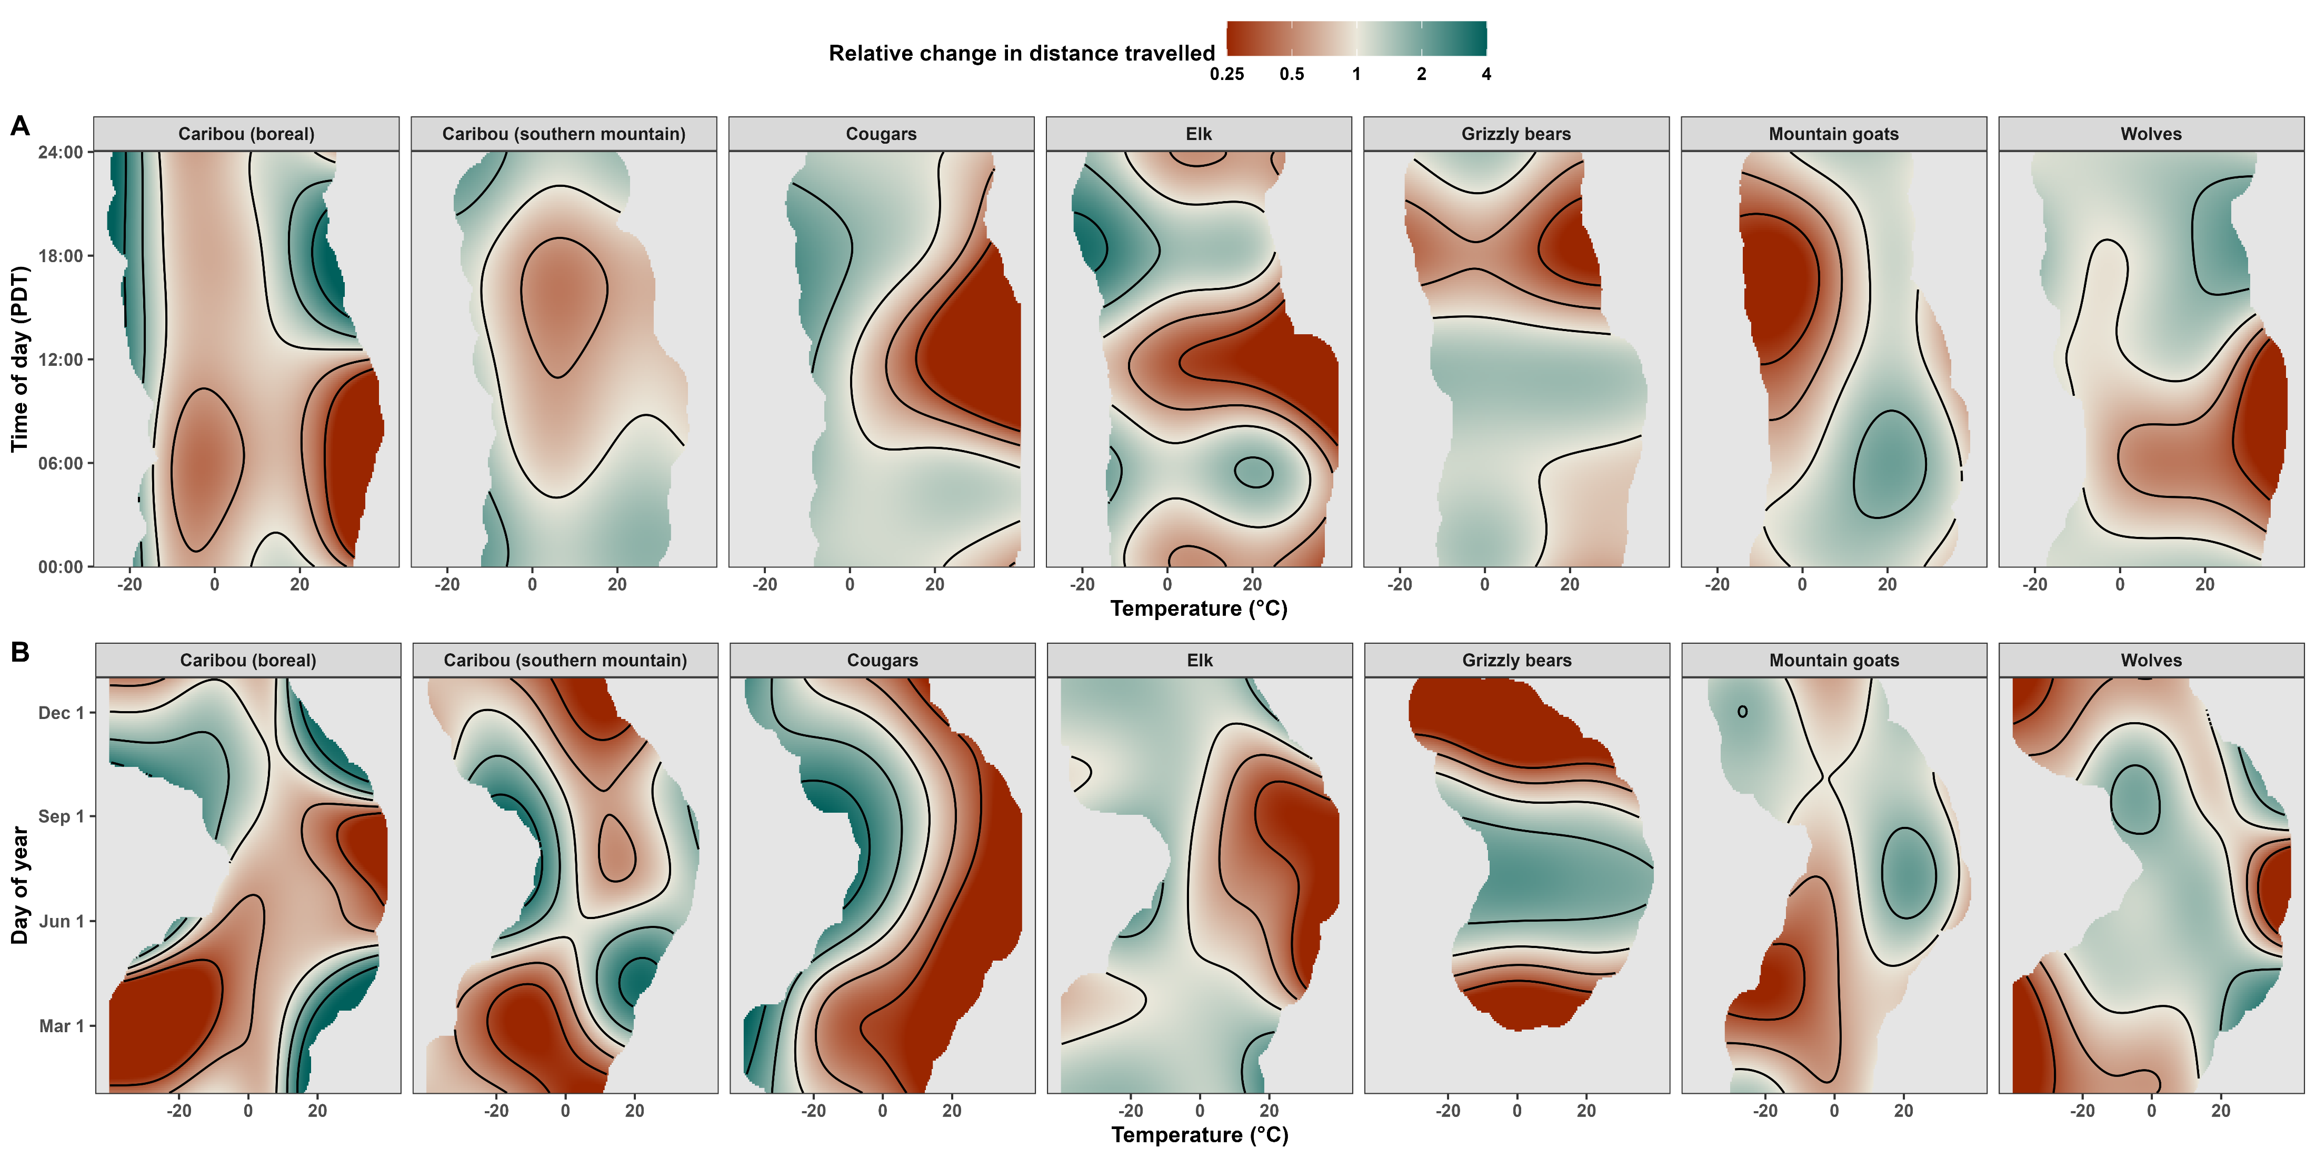


The heat is on: Rising temperatures alter when, how, and where large terrestrial mammals move
Stefano Mezzini
Ph.D. Biology candidate

Slide 2
A bit of history…

Slide 3
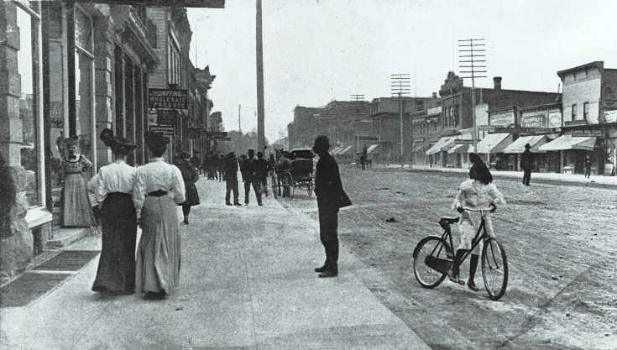
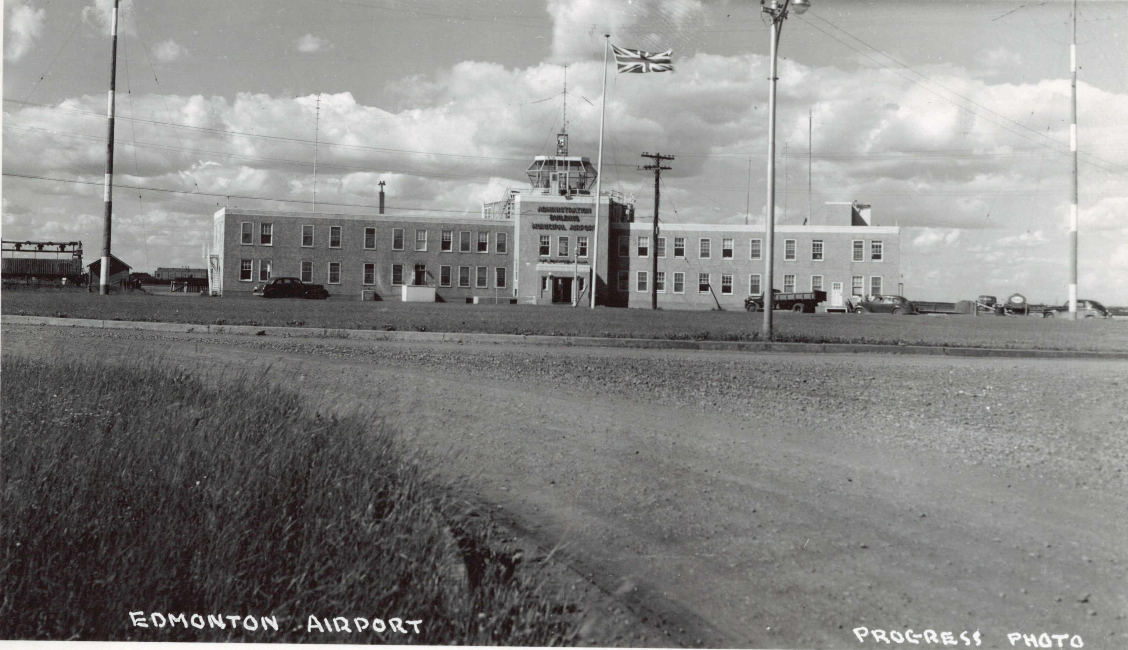
Edmonton has changed since 1925
1905: Alberta becomes a Canadian Province
1910s: Population boom
1916: Population crashed by 19 000 (26%)¹
1929: City Centre Airport opens
Jasper Ave circa 1910
https://archive.org/details/PC012149

Slide 4

The Land before Edmonton: Amiskwaciy Wâskahikan
Canada was founded on colonial beliefs and actions
Other Peoples lived with these Lands for millennia, including:
Nehiyawak (Cree),
Stoney Nakoda,
Niitsítpi (Blackfoot),
Tsuut’ina, and
Michif (Métis) Peoples.
Amiskwaciy Wâskahikan was a well-known
Now part of Treaty 6
Notes:
Nehiyawak: https://youtu.be/mjTFh_AnYmY?si=aHFz0t2AFfP71XbN&t=13
Stoney Nakoda are also called Ĩyãħé Nakón mąkóce, but I couldn’t find a clear pronunciation of the name
Niitsítpi: /nit’si’tpi/ https://youtu.be/A0e6I6wKi9Q?si=pHiNdlrHEurcllrJ&t=16
Tsuut’ina: /tsuu-tèna/ https://youtu.be/iuoUF0n90iU?si=MlgeoB0_fII3lBVA&t=17
Michif: https://youtu.be/NxwL20Kf0YA?si=kAZ4o-otCz1-ju2B&t=245

Slide 5
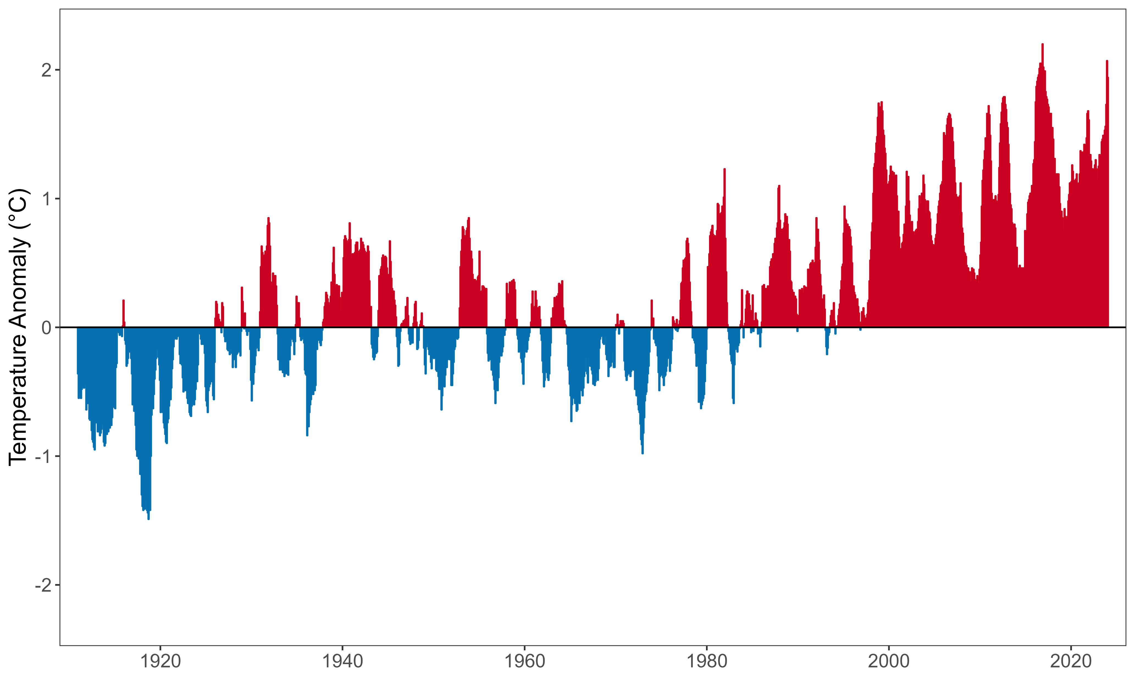
The weather is getting warmer
(Relative to the 1910-2000 average)

Slide 6
What will western Canada look like in 2100?

Slide 7
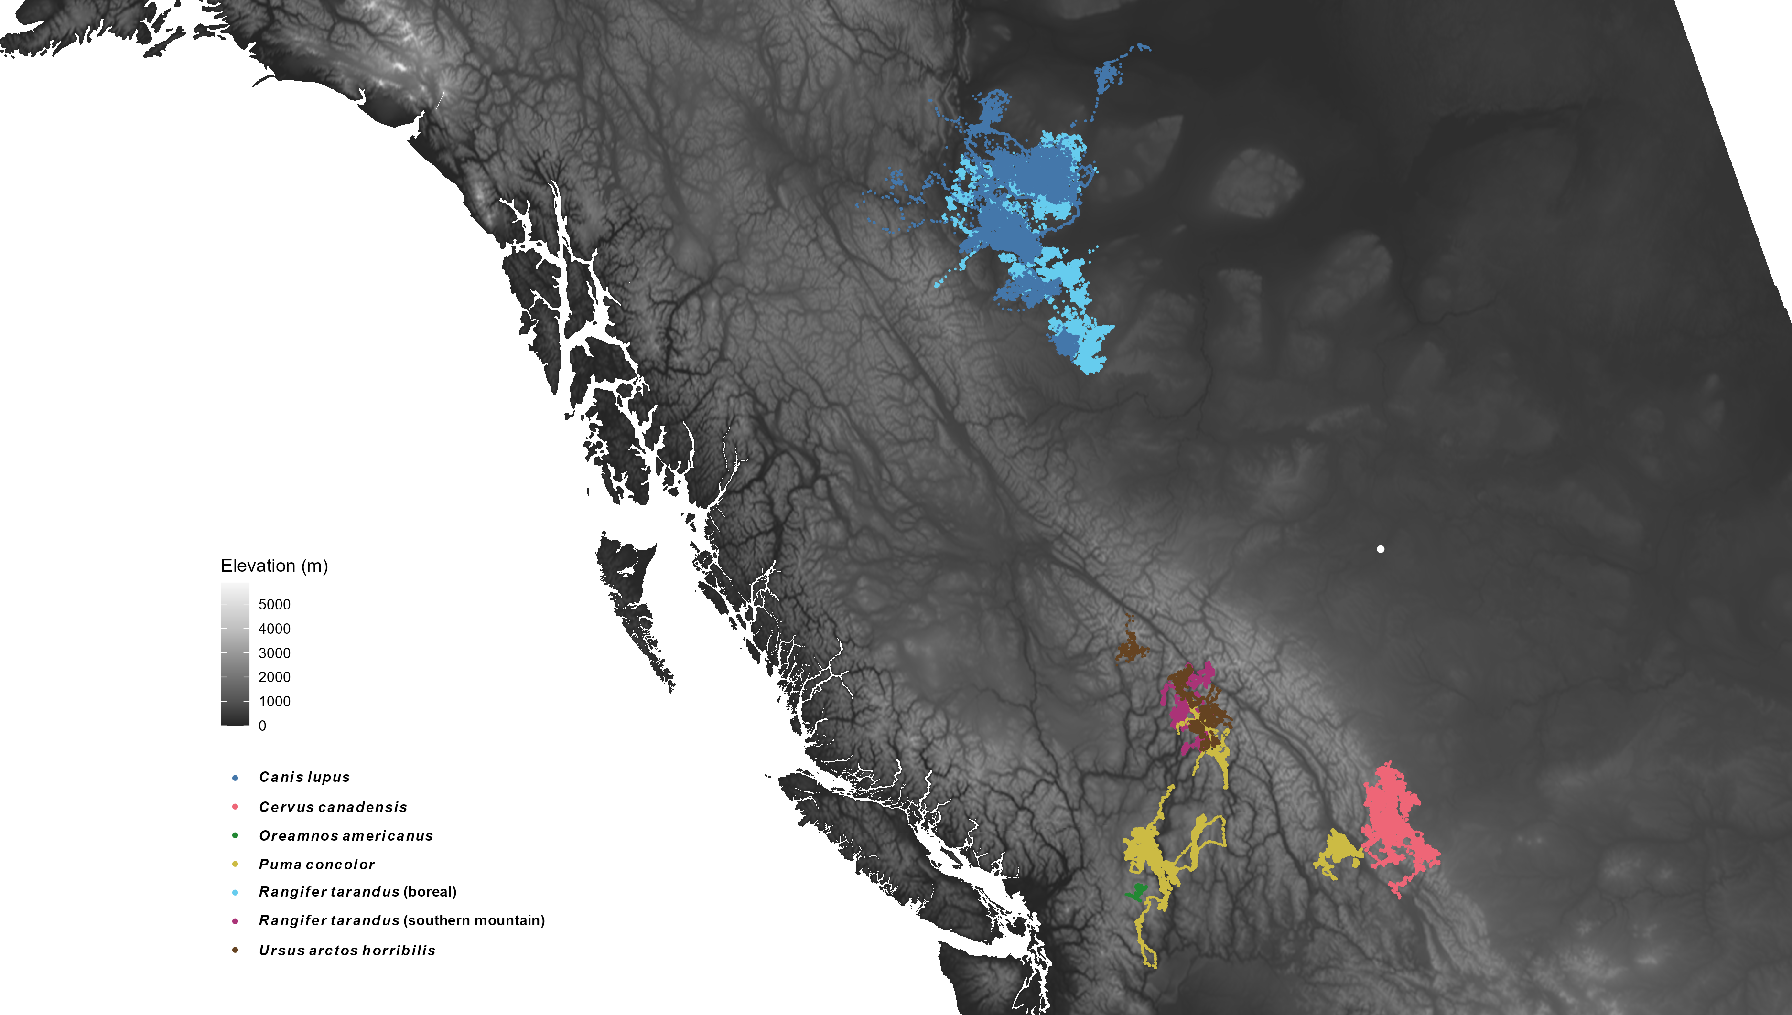
Remove telemetries

Slide 8


6 mammal species
2 caribou ecotypes
1.5 million GPS locations
Edmonton

Slide 9






There are many things that affect movement behavior

Slide 10
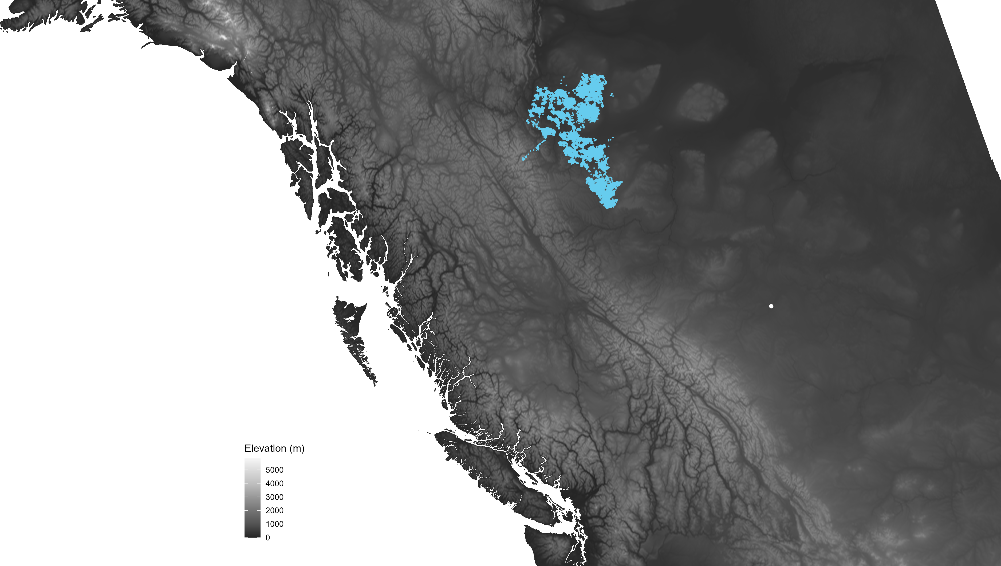
Edmonton

Slide 11
Temperature & movement rates

Slide 12
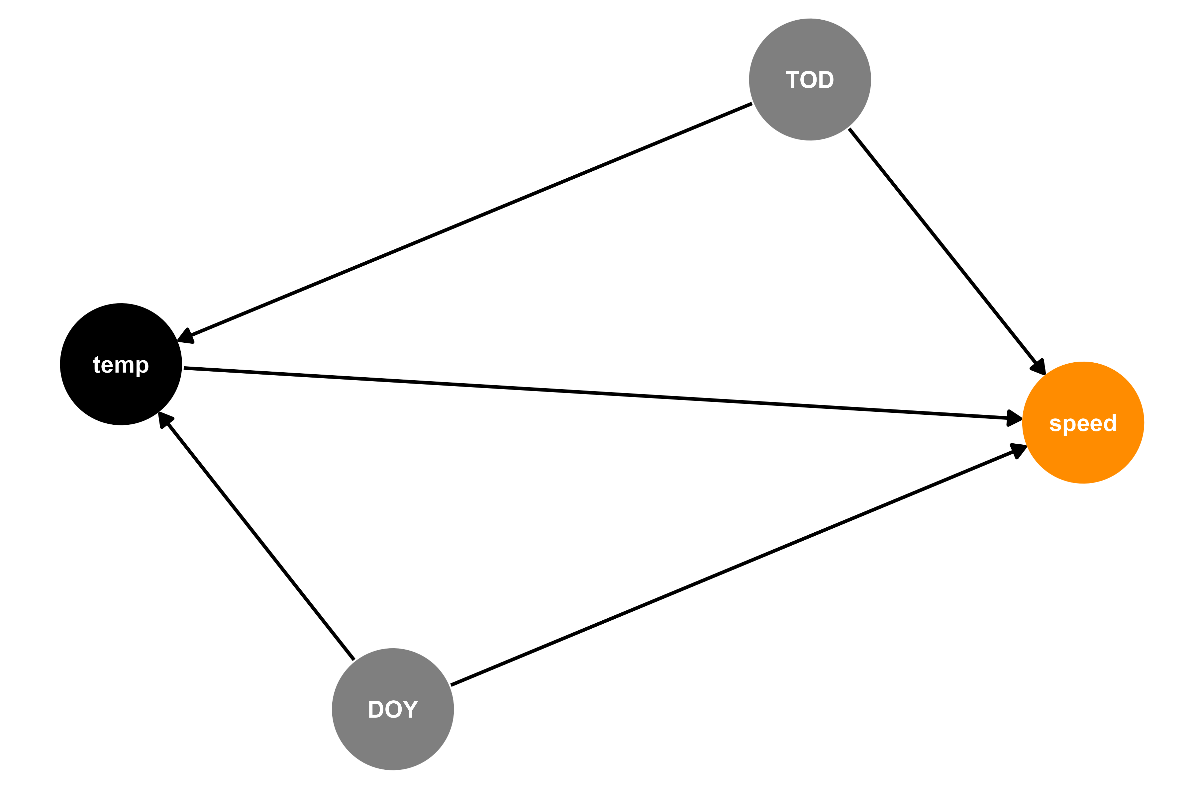


Modeling how boreal caribou move
distance

Slide 13


Temperature alters movement rates

Slide 14
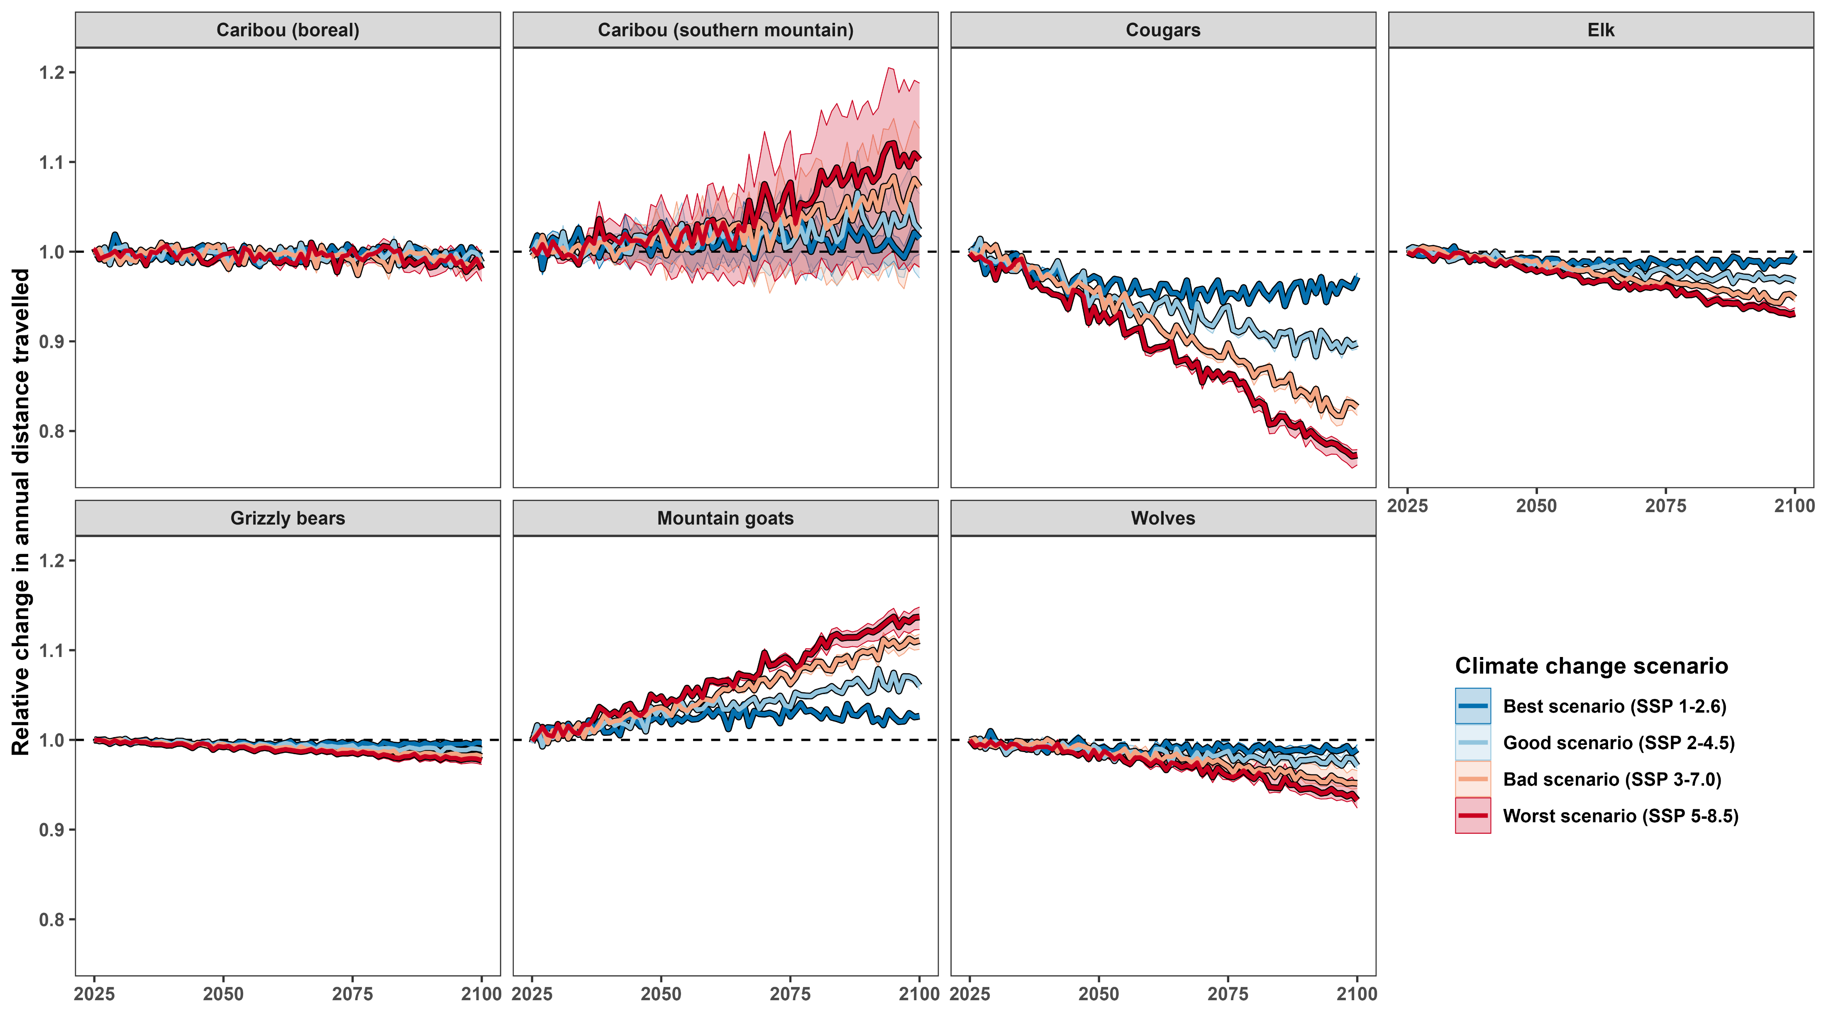



Climate change may not change annual averages much…

Slide 15
… but seasonal phenology may still change

Slide 16
Temperature & habitat selection

Slide 17
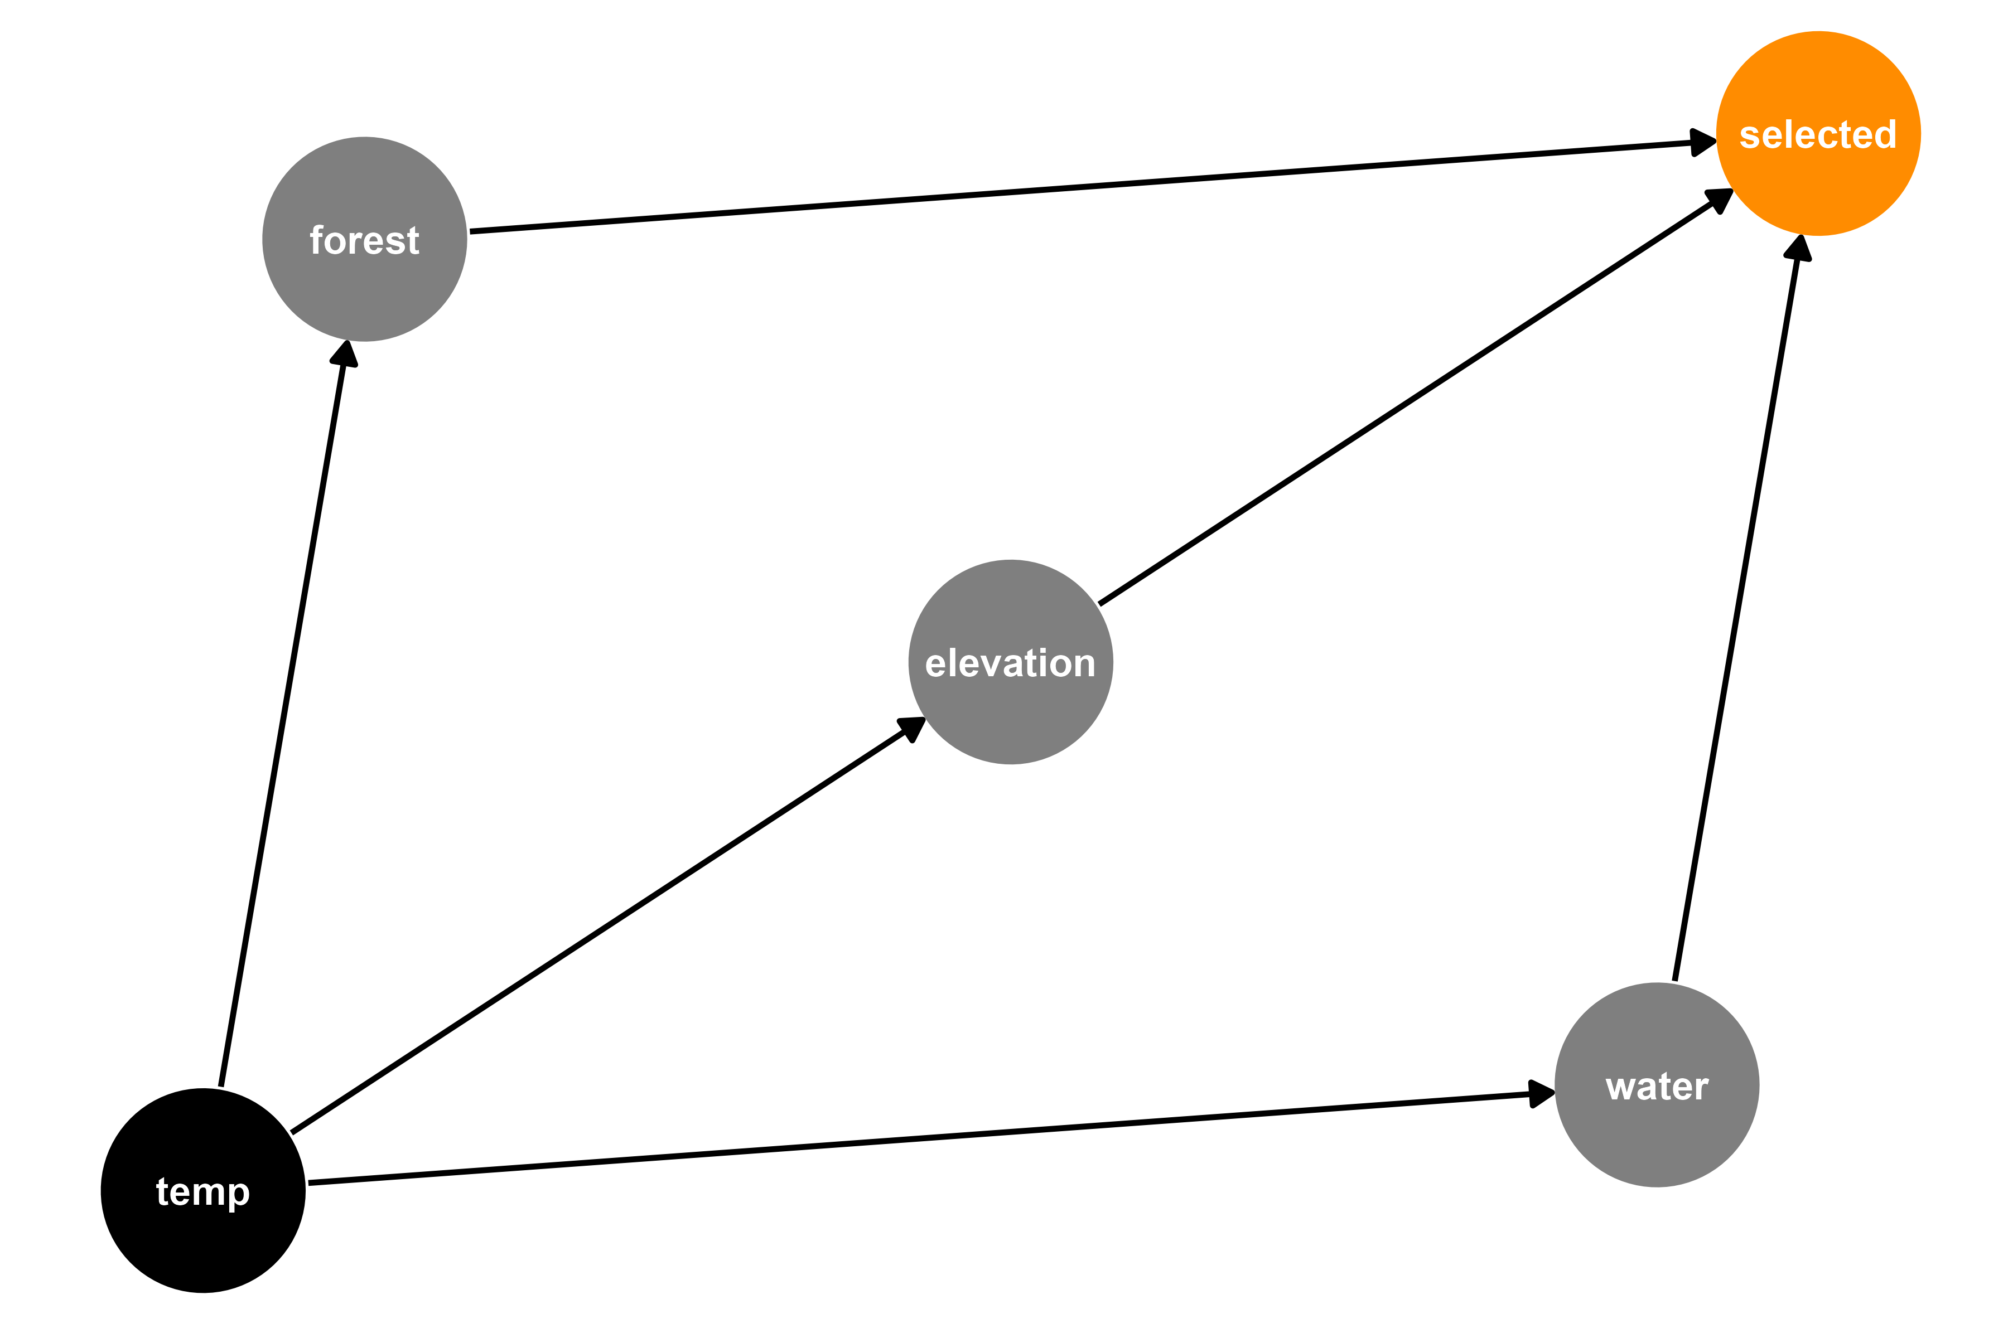



Modeling where boreal caribou move

Slide 18
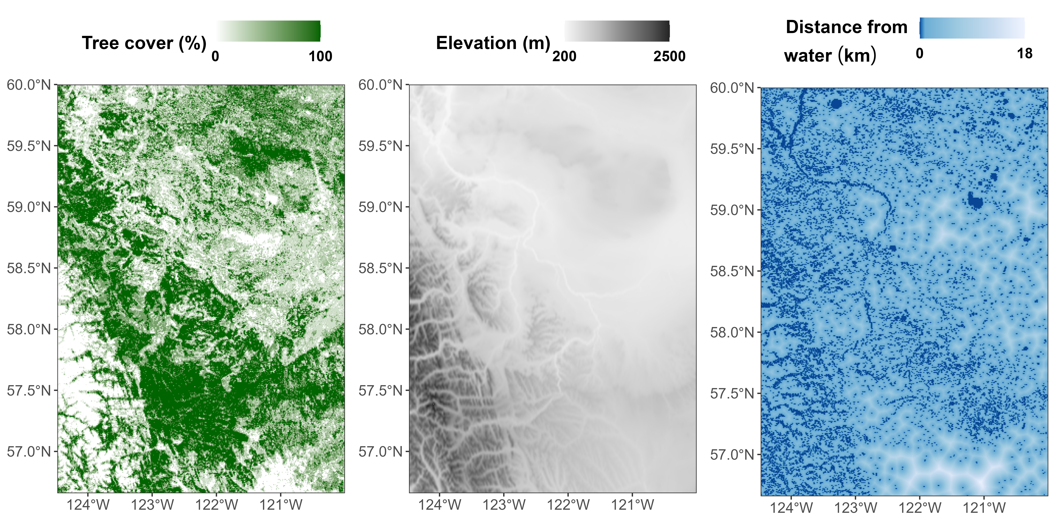
A simple resource selection function

Slide 19
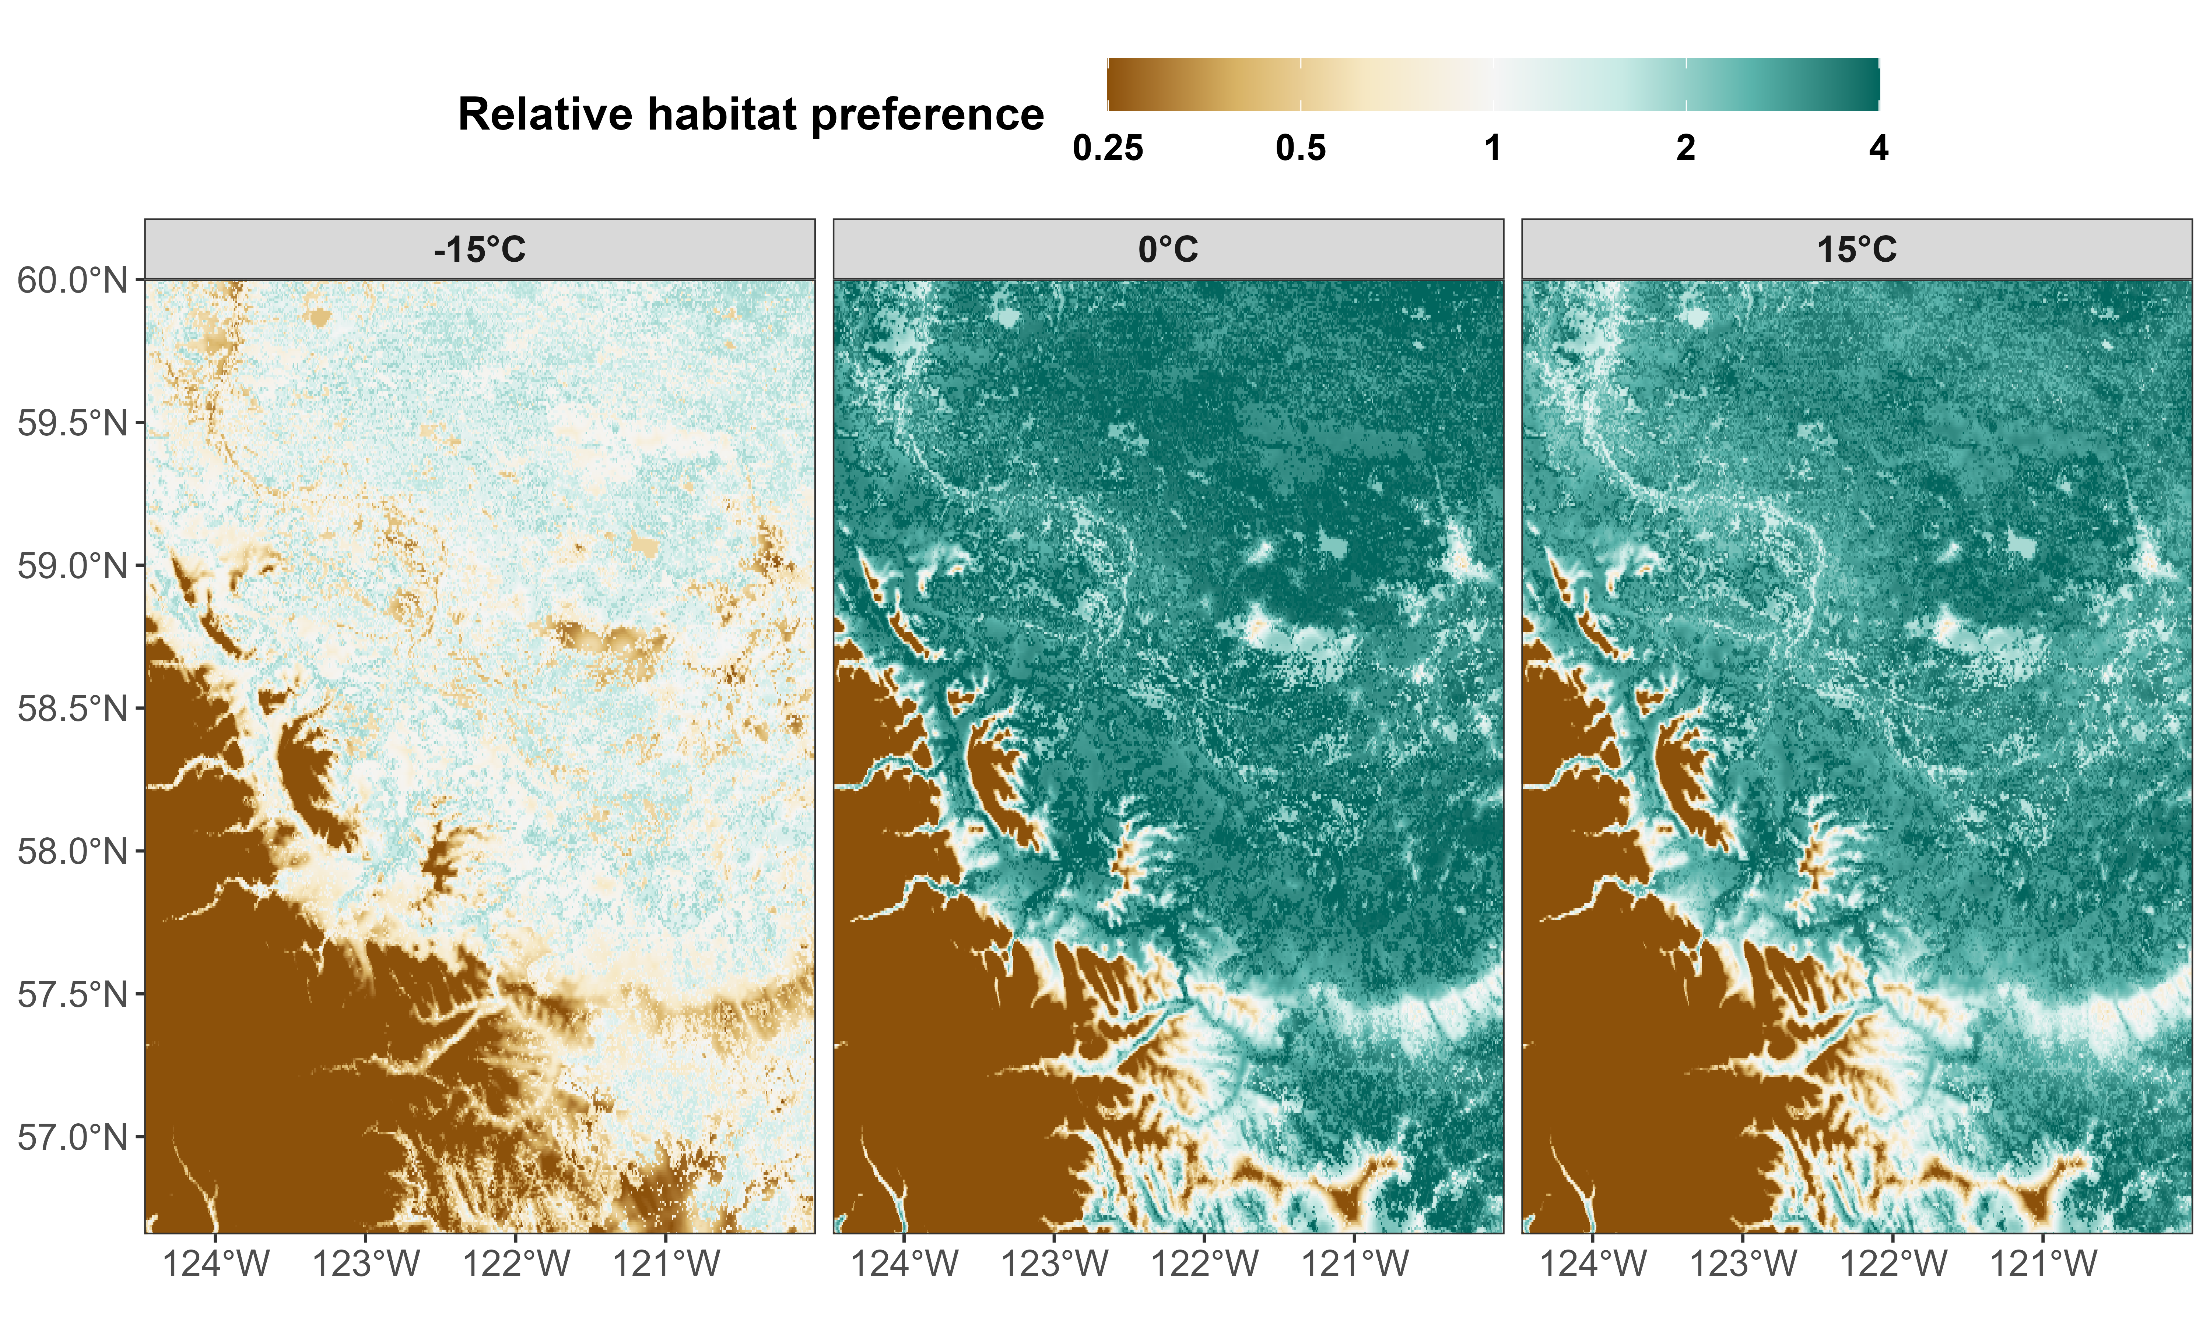


Habitat selection depends on temperature
update

Slide 20
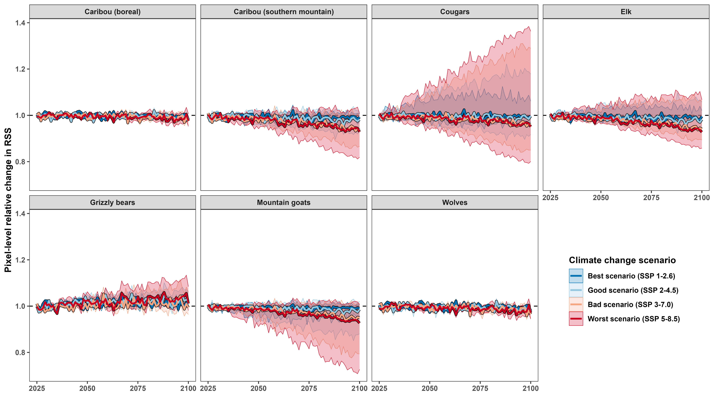

Climate change may not change annual averages much…
Like
Dislike

Slide 21
… but seasonal phenology may still change

Slide 22
6 mammal species
2 caribou ecotypes
1.5 million GPS locations
Edmonton

Slide 23
Add results for wolves and other species

Slide 24



Consequences for conservation
Predicting the future using historical data is hard:
Mammals’ responses to temperature are nonlinear
Little data at extreme temperatures
No good simulations of daily/hourly weather
No good predictions of what habitats will look like
Protect areas proactively
May need to change current protected areas
GitHub Repo

Slide 25






Acknowledgements

Slide 26
DUPLICATE CONCLUSION SLIDE
GitHub Repo

Slide 27
References and credits
1. http://webdocs.edmonton.ca/InfraPlan/demographic/Edmonton%20Population%20Historical.pdf
Cougar phylopic: CC BY-NC 3.0: Cristian Osorio & Paula Carrera, Proyecto Carnivoros Australes
Mountain goat phylopic: CC-BY-SA 3.0: Sarah E. Haworth
R code can be found at https://github.com/QuantitativeEcologyLab/bc-mammals-temperature

